Slide 1

DMART Superstore Sales Dashboard
Comprehensive analysis of 9,994 orders from 50 customers, generating $15M in revenue and $4M in profit across multiple regions and categories.

Slide 2
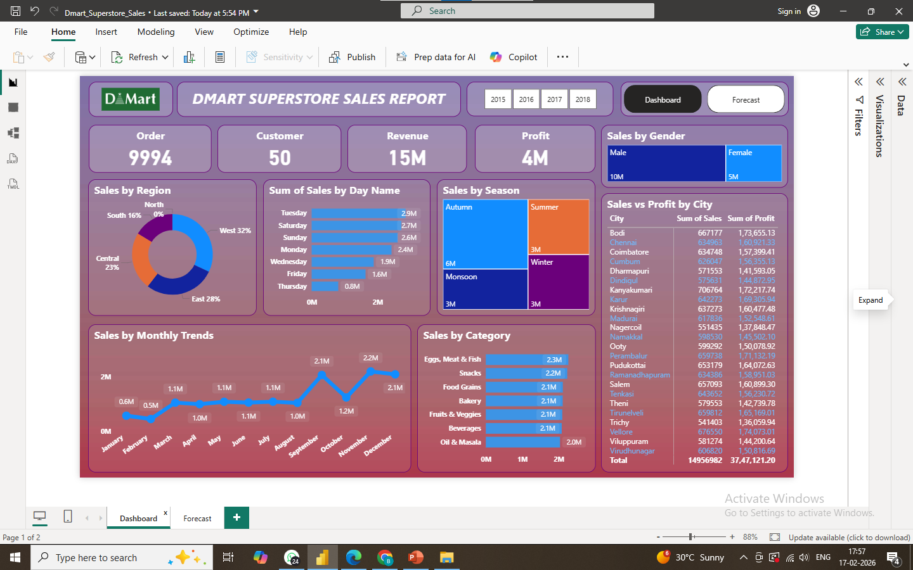

Slide 3
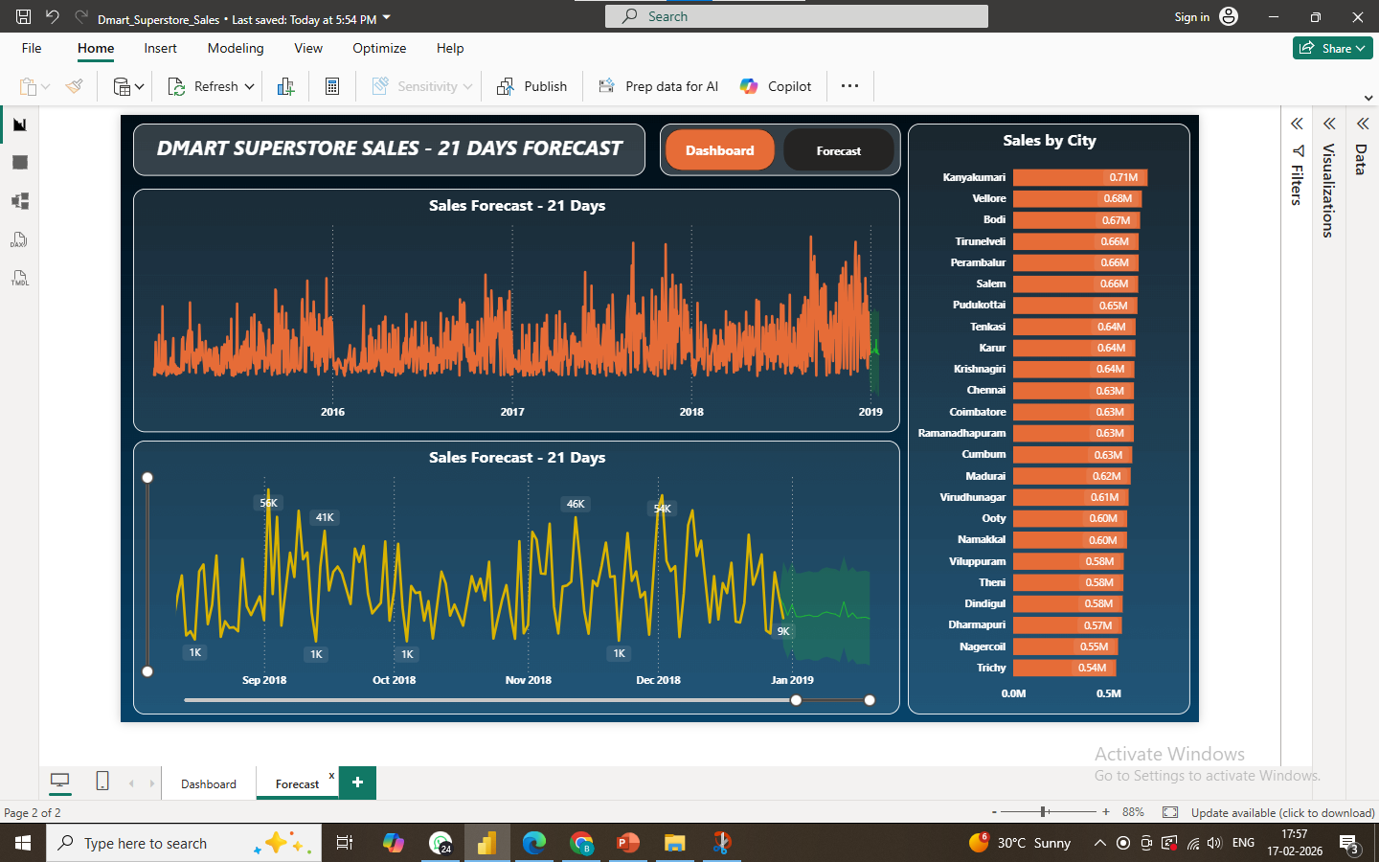

Slide 4
PERFORMANCE OVERVIEW
Key Business Metrics
9994
50
$15M
$4M
Total Orders
Active Customers
Revenue Generated
Profit Earned
Orders processed across all regions
Customer base served
Total sales revenue
Net profit margin achieved

Slide 5
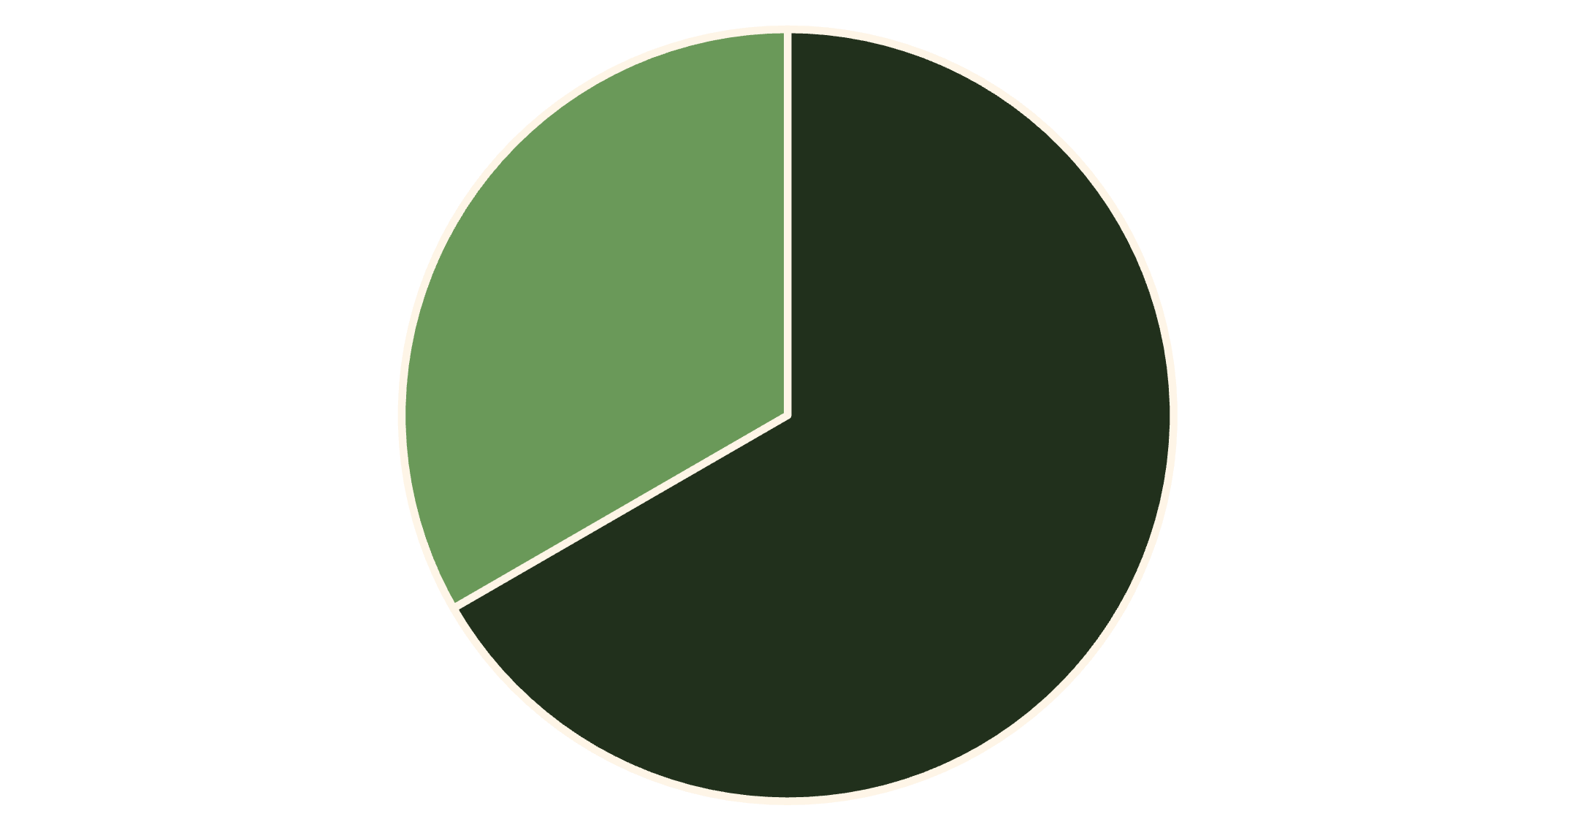
Sales Distribution Analysis
Sales by Gender
Male customers account for $10M (67%) of total sales, while female customers contribute $5M (33%). This significant gender disparity suggests opportunities for targeted marketing strategies.
Male
Female

Slide 6
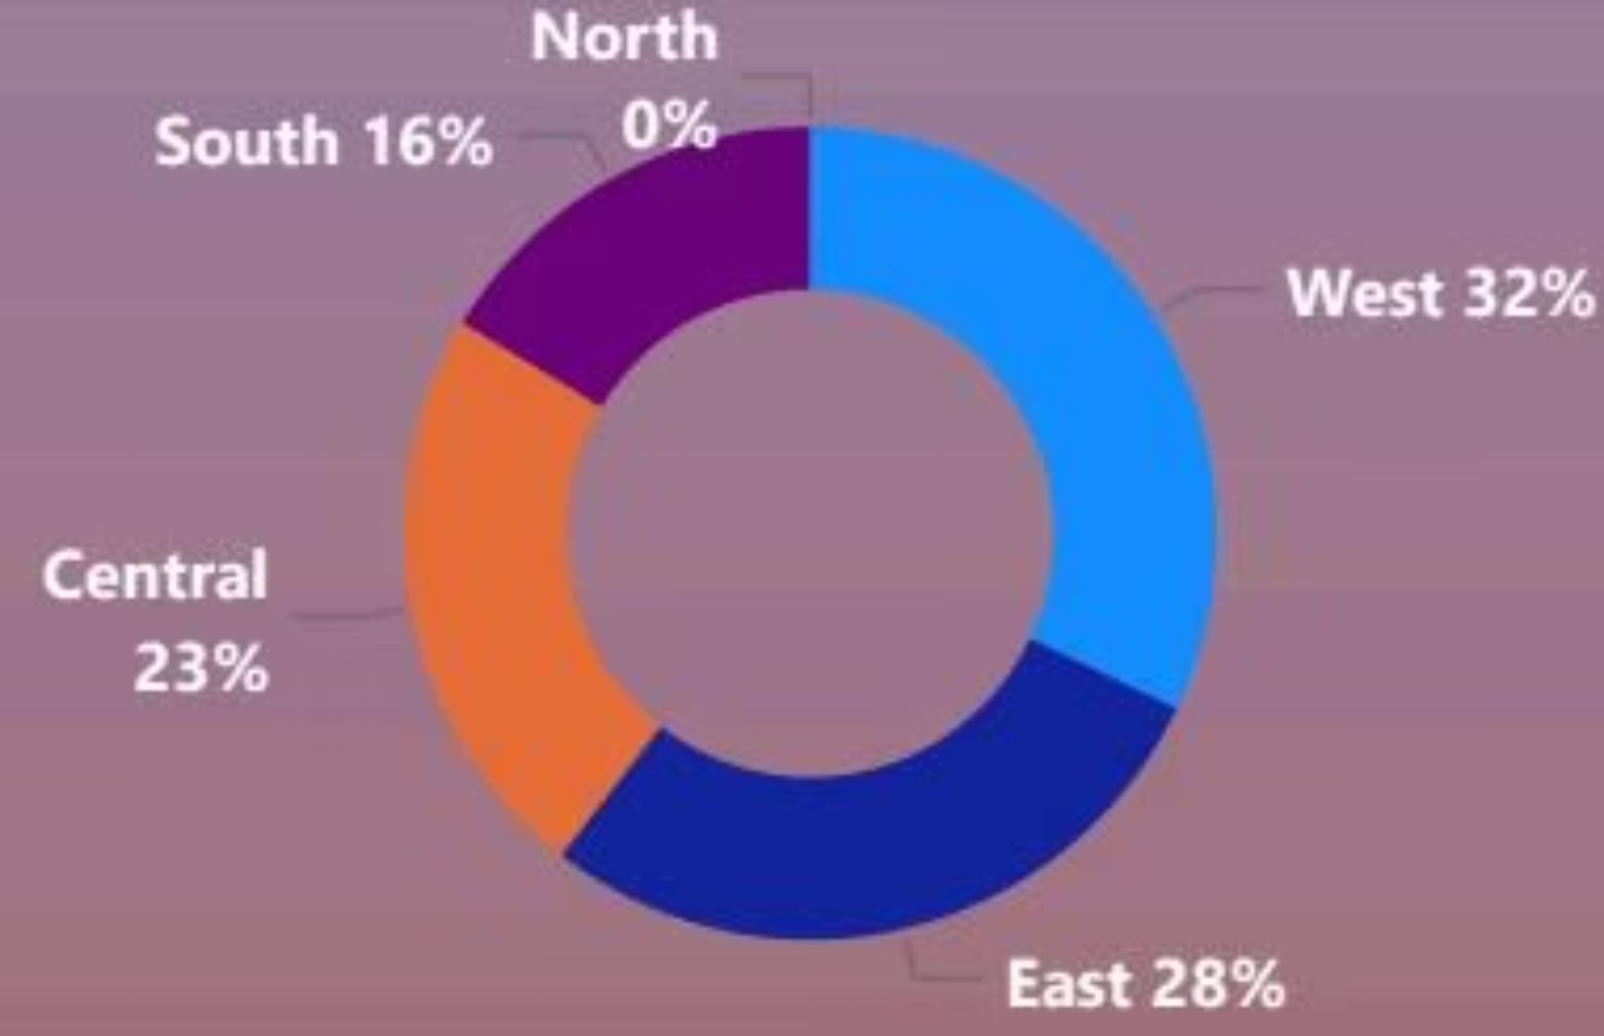
Regional Performance Breakdown
Sales by Region
West region leads with 32% of sales, followed by East (28%) and Central (23%). South contributes 16%, while North shows zero sales—indicating a critical expansion opportunity.
West: 32%
East: 28%
Central: 23%
Top performer
Strong market
Solid presence

Slide 7
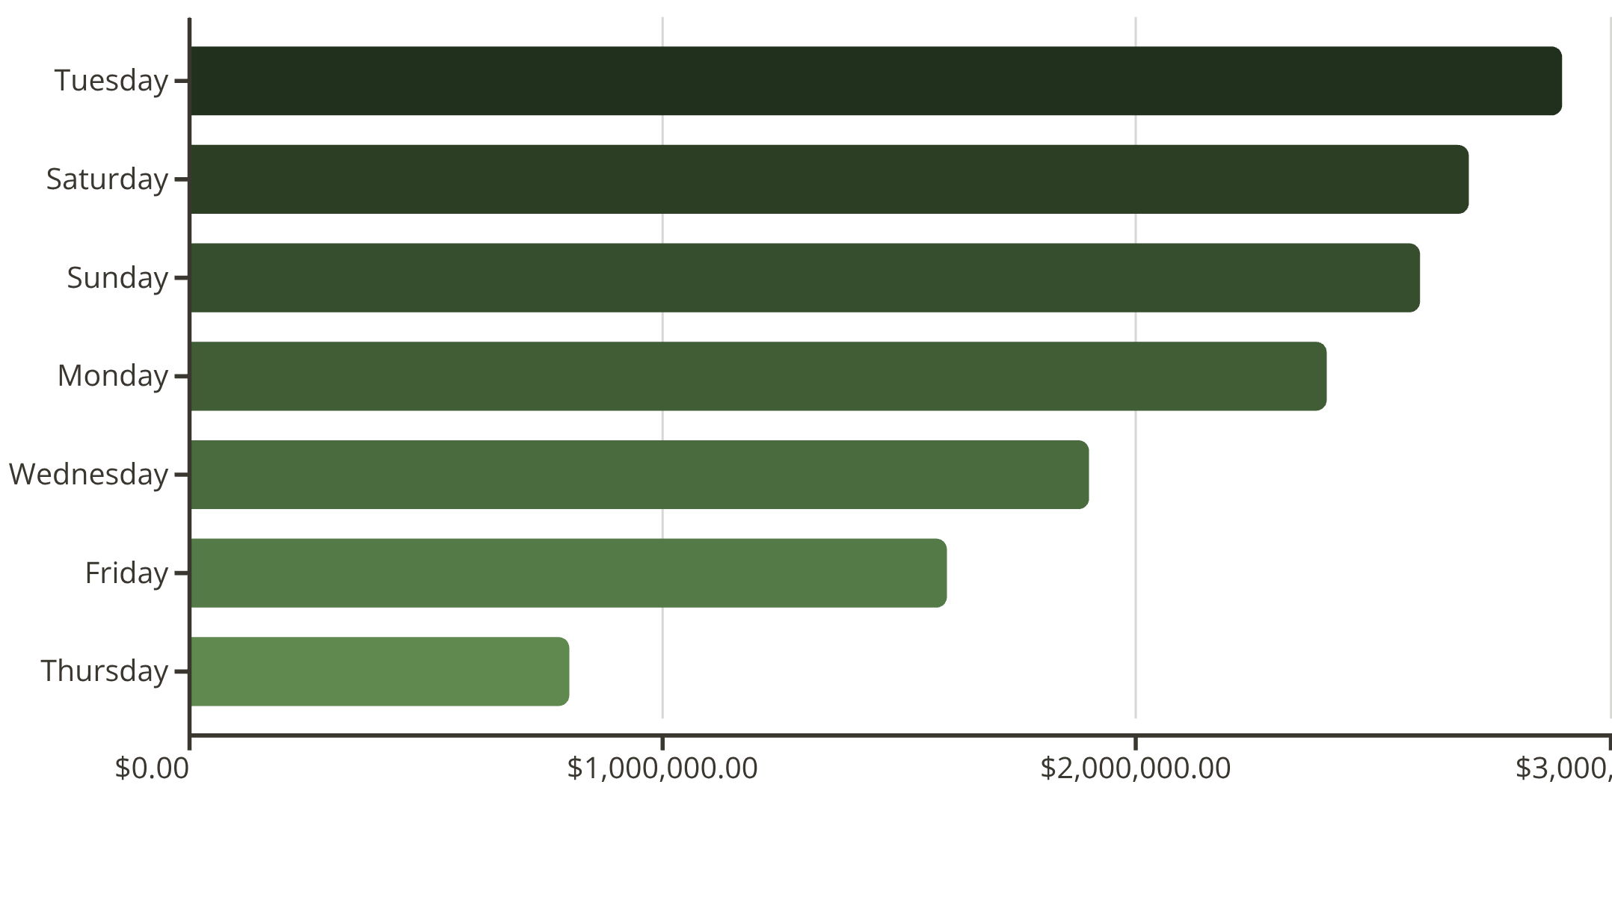
Weekly Sales Patterns
Daily Sales Trends
Tuesday dominates with $2.9M in sales, followed by weekend days. Thursday shows the weakest performance at $0.8M, suggesting staffing and inventory optimization opportunities.

Slide 8

Seasonal Sales Performance
Autumn
Summer
$6M in sales
$3M in sales
Peak season driving 40% of annual revenue
Consistent performance with 20% share
Monsoon
Winter
$3M in sales
$3M in sales
Stable demand throughout rainy season
Balanced contribution to annual total

Slide 9
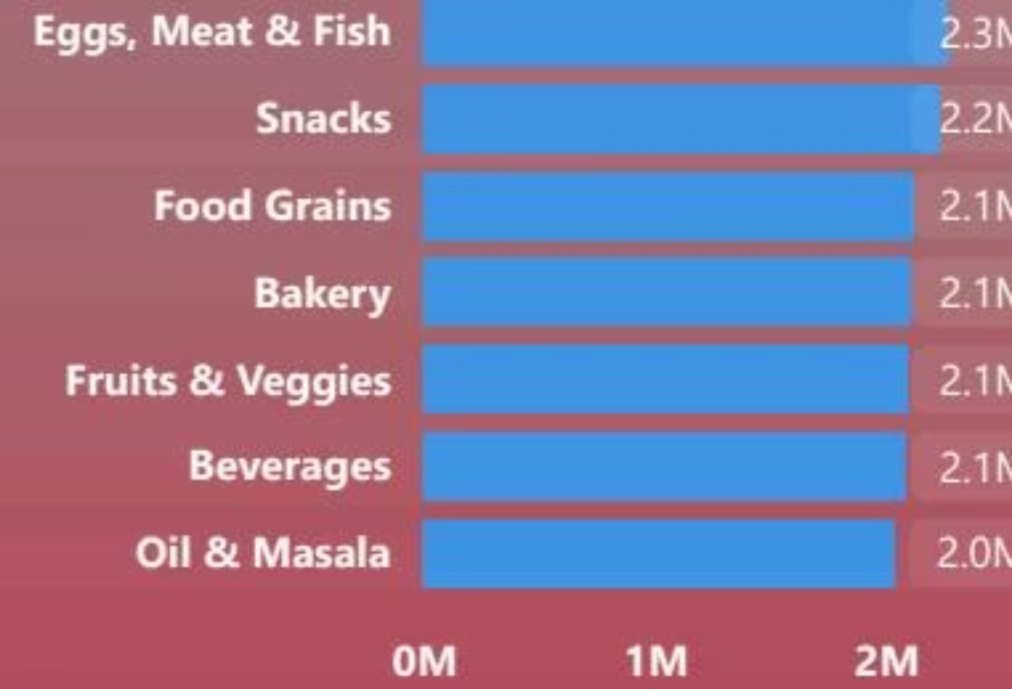

Category Performance Leaders
Top Categories
Eggs, Meat & Fish leads at $2.3M, followed closely by Snacks ($2.2M). All major categories show balanced performance between $2.0M-$2.3M, indicating diverse customer preferences.
Key Insight: Relatively even distribution across categories suggests strong inventory management and customer satisfaction across all product lines.

Slide 10
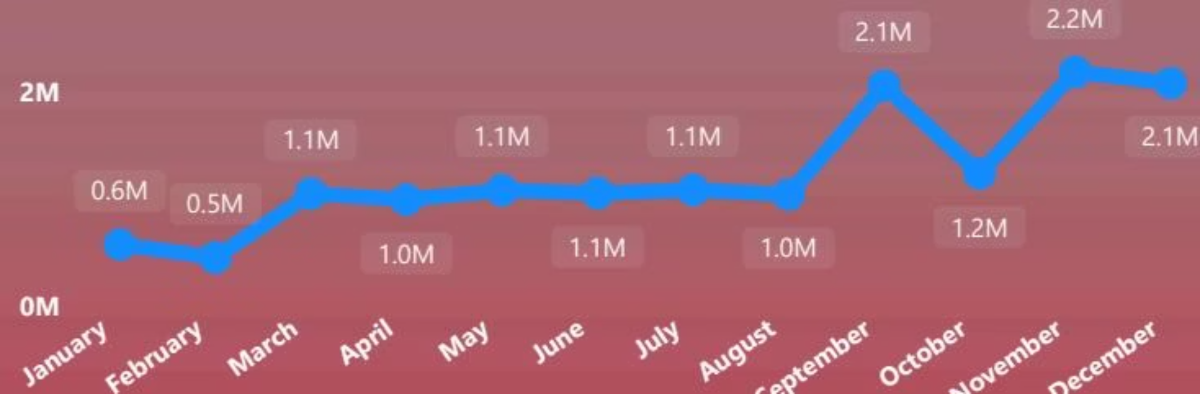
Monthly Sales Trajectory
Year-Round Trends
Sales peak in Q4 with November ($2.2M) and December ($2.1M) leading. September also shows strong performance at $2.1M. Early year months (Jan-Feb) represent the slowest period.
Q4 drives 35% of annual sales
Mid-year maintains steady $1.0M-$1.1M
Strategic planning needed for Q1 growth

Slide 11
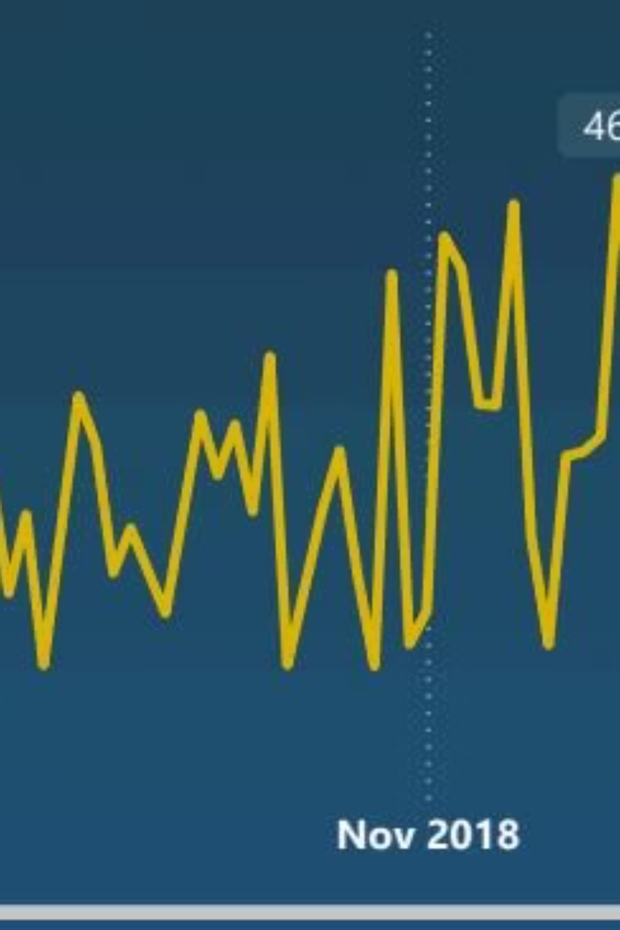

FORECAST
21-Day Sales Forecast
Predictive analysis shows significant volatility with peaks reaching $56K and $54K in early September and late November. The green forecast range widens toward year-end, indicating increased uncertainty during holiday periods.

Slide 12




Top Performing Cities
Kanyakumari
Vellore
Chennai
Coimbatore
$0.71M in sales with $172K profit—highest revenue city
$0.68M in sales with $174K profit—best profit margin
$0.63M in sales with $161K profit—major metro market
$0.63M in sales with $157K profit—industrial hub
24 cities contribute to total revenue of $14.96M with combined profit of $3.75M. Top performers show consistent profitability across diverse geographic markets.

